Slide 1

6372 Unit 3 Pre Live Assignment
By-Rashmi Patel

Slide 2
6372 Unit 3 Discussion 1
The data set is provided in MathACT.csv along with some SAS code. The convenient thing about two way anova’s (once decided that’s what we have) there is no need for model selection type things as we know exactly what predictors we have to work with and that there are only two. This also helps as we do not have to worry as much about multicollinearity issues that we discussed before. The SAS code has 3 main components. 1. Read in the data and create some summary statistics tables 2. Create a profile plot of the summary statistics. 3. Run a two-way ANOVA model. The plot is a little bit complicated to build in SAS but it’s very helpful and you can use it as a template to plot other data in a similar fashion so it will help to play around with that on your own.
There are a few times throughout the videos where the discussion of additive and nonadditive models (there is a good section in the book on this). The best way to visually investigate whether which one is more appropriate is through a simple visualization of the mean ACT scores by the different groups of the factors. Using the plot as a guide and your knowledge from the videos and text, what type of model (additive or nonadditive) do you think most appropriately fits this data set? Be prepared to explain your choice.

Slide 3
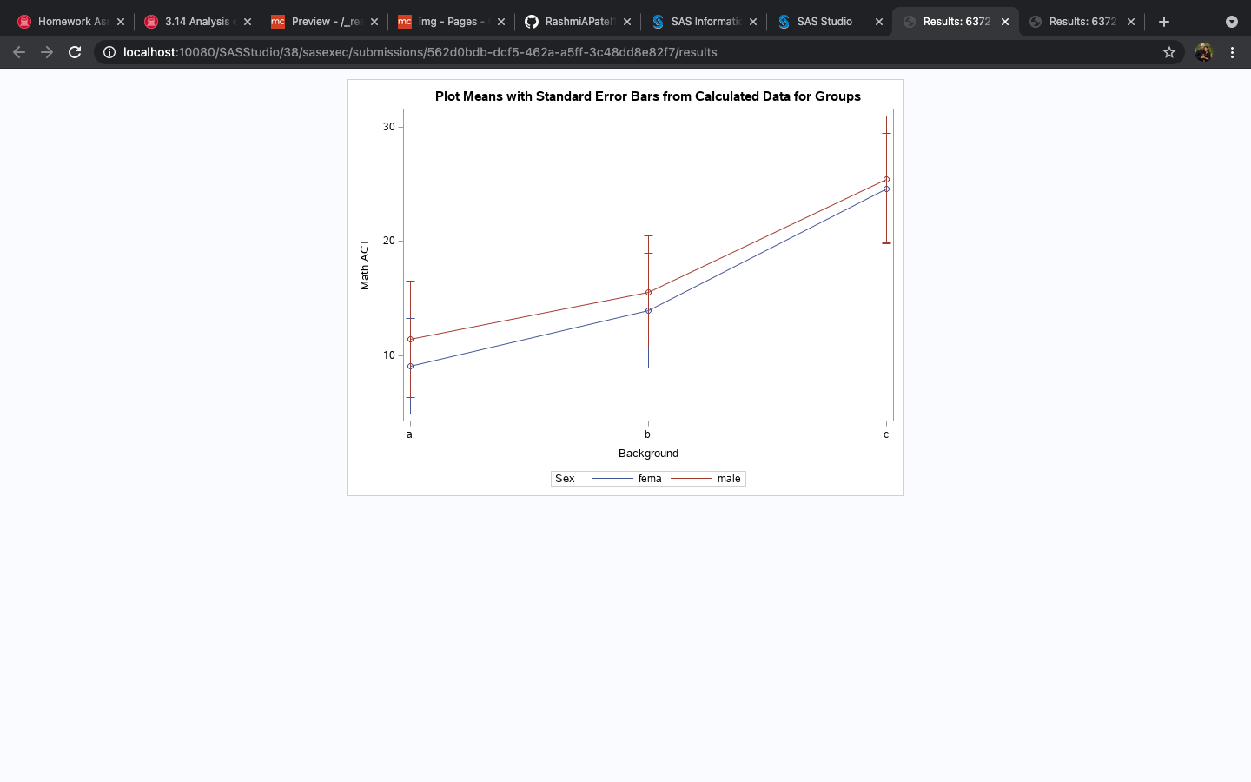
6372 Unit 3 Discussion 1
For MathACT.csv, it seems that the category C has higher ACT scores than other 2 categories but the differences in scores of male and female seems to be getting reduced as the category includes more mathematics coursework. In category 3, the males are having higher ACT score than females.

Slide 4
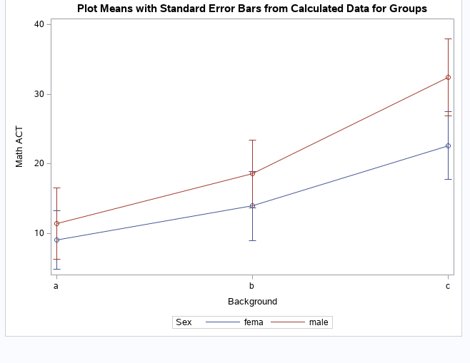
6372 Unit 3 Discussion 1
For MathACT_2 .csv, it seems that the category C still has higher ACT scores than other 2 categories but the differences in scores of male and female seems to be getting increased as the category includes more mathematics coursework. In category 3, the males are having much higher ACT score than females.

Slide 5
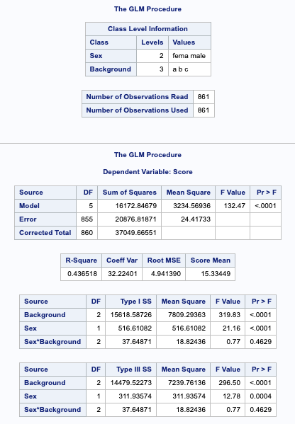
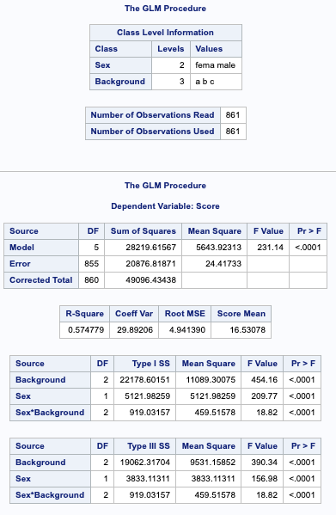
6372 Unit 3 Discussion 1
Both model are non-additive as it contains an interaction term in it. Talking about the F-tests tables, all the F-tests tables for MathACT_2.csv model have much higher F-value value than MathACT.csv model F-value.
The F-value for the table of Type III SS is 390.94 for MathACT_2.csv model which seems to be much higher than MathACT.csv model Type III SS table F-value which is 296.50.
In the model for MathACT.csv obtained the main term as significant and interaction term as insignificant whereas the interaction term as well as the main term in MathACT_2.csv model are significant.

Slide 6
6372 Unit 3 Discussion 2
In addition to the general F-tests, I’ve included some additional options with the lsmeans and estimate statement. These options are used to write specific contrasts to conduct hypothesis tests that are a little more specific than what F-tests tell us. Take a look at the output and find the Estimates table. There are three different tests that I asked SAS to do. For the first one, I tell you exactly what I’m testing for, I want you to see if you can decipher what the other two are testing for. Besides the estimate table and the sas code, there is another table within the output (LSMean tables) that could possibly help so be sure to take a look at the other output results (note: I’m referring here to an actual number table, not some of the graphics, the graphics can be a little confusing). You only need to use the first data set for this discussion.

Slide 7
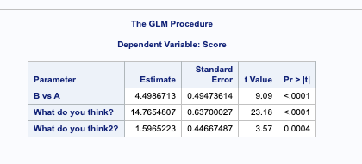
6372 Unit 3 Discussion 2
The given image is the estimates table for contrast.
The first estimate is for category B versus category A which seems to be significant looking at the table.
The second estimate is for category C versus category A which also seems to be significant looking at the table
Last estimate is for the Male versus Female which also seems to be significant looking at the table.

Slide 8
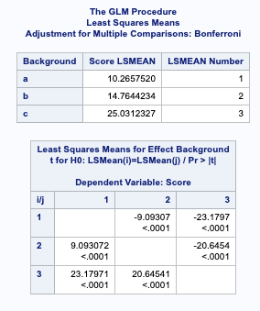
6372 Unit 3 Discussion 2
The given image is the least squares means table which has Bonferroni adjustment to it.
Looking at the table we can say that all the background are significant and more is the mathematics coursework one student do for ACT, the higher score will be achieved.

